Slide 1
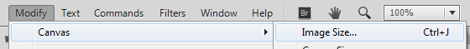
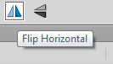
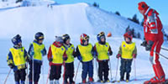
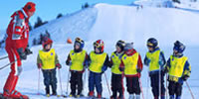
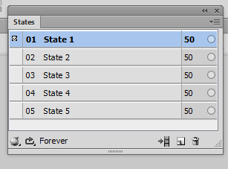
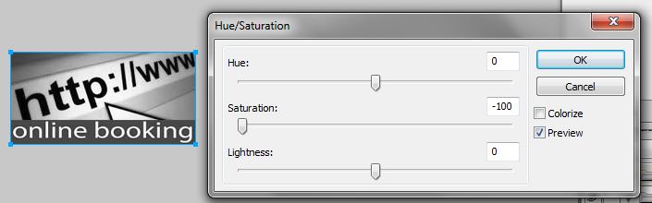
Web Authoring (Ski Resort Task)
Task 3 – Graphics
Open the SkiImageC image in a suitable graphics software: Change the width of the image to 400px wide and maintain the aspect ratio. Reduce the resolution (quality) of the image so the file size is less than 40k. Export as a jpeg and name the file Ski_C
2. Open the LearnE image in a suitable graphics software: Flip the image – Horizontal Save the changes.
3. In a suitable graphics software you will create an animated GIF image to promote the ski resort: Set the canvas to the following size: Width 400, Height 100 Create 5 States – Set appropriate frame rate In each state you will include a different image with appropriate text. You will export the image as a GIF and will select 256 colours. You will name the file Promotion
4. Open the BookingL image in a suitable graphics software: Apply greyscale to the image. Save the changes
Before
After

Slide 2
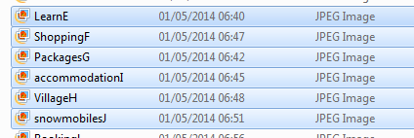
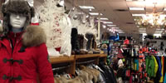

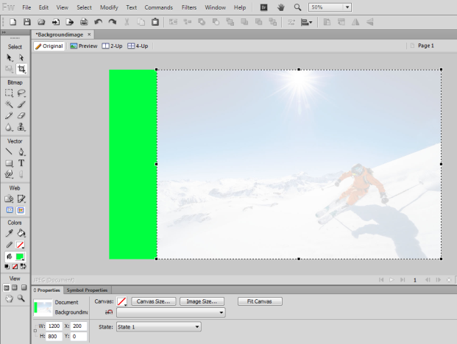
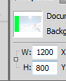
Web Authoring (Ski Resort Task)
Task 3 – Graphics
Open the images highlighted below in a suitable graphics software: Apply appropriate text to each image – Refer to the filename Make sure the formatting is consistent. Save the changes (You can include shapes so that the text stands out)
Open the Backgroundimage image in a suitable graphics software: Crop the image so the green rectangle is not included. Make sure the crop area shows the sizes below: Save the changes
Before
After

